Slide 1
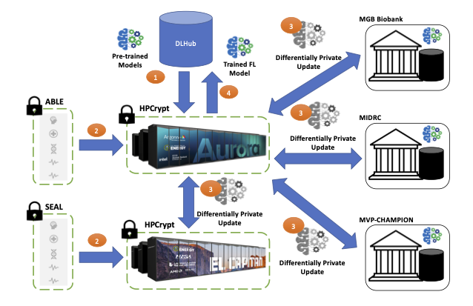

learning data science, federated learning and appfl.
Abiodun Adejare, Data Science and Learning Division
Before starting this internship I had little to no knowledge on what data science was and what it stood for . In this poster, I would be taking you along on my personal journey of what I have learnt and what I am still in the process of learning. Data Science is used all around us for instance, imagine you’re listening to a song and randomly when the song ends a similar one starts to play, that’s data science. I have spent the last few weeks trying to understand how this works and ways I can use data science to create programs. I was assigned to work under my mentor Mr Ravi Madduri on the PALISADE-X project which has a main objective to develop Argonne Privacy Preserving Federated Learning (APPFL) framework.
INTRODUCTION
As scientists, we provide a lot of data while actively consuming it. A big question is how can we share our data and receive new data without risking our research? we can achieve that through federated learning.
I was tasked to follow the instructions and run the program and as I progressed I thought of the idea of having a decision tree linked into the program to help programmers who got stuck along the lines of running the program.
A decision tree is simply a graph that uses a branching method to illustrate every possible outcome for a specific input.
DECISION TREES, UNDERSTANDING DATA & FEDERATED LEARNING.
HANDLING MISSING DATA
Right above, I created an illustration to show how a decision trees works, it simply uses an algorithm that let’s the user choose how to proceed when making decisions. The graph above illustrates how our next steps are determined by the path we choose to follow.
During my research, I kept on think of how we come across a lot of data daily and then I became curious as to how data scientists are able to still get results even when the parts of the data are not available. I started to read up on it and I came across “imputation or data removal” and it simply means that data scientists can either choose to assume what was missing by methods of adding the most similar forms of data or implementing a mean, median and mode algorithm. Scientists try to modify the data and get the most accurate results and in times when this is not entirely possible they rely on deleting some of the said data. Deletion of data can cause a lot of harm because it creates room for even lesser accurate results.
FEDERATED LEARNING
Federated learning is a machine learning technique that trains an algorithm across multiple decentralized edge devices or servers holding local data samples, without exchanging them. It can sometimes be described as the simple form of machine learning. The APPFL is an open source software framework that allows research communities to implement, test , and validate various ideas for privacy preserving learning federated framework. With that, users can train a user- defined neutral network model on decentralized data with differential privacy.
USING PYTHON FOR DATA SCIENCE
WHAT NEXT?
I will be doing more research on Data Science
and how I can use it’s concepts to develop programs
That better our everyday lives.
You can scan this QR code in which I have linked my
Github repository where you would be able to find the
Documentation I did from the past 10 weeks and I would
Continue updating it as time progresses.
For my work this summer I used previous knowledge of python to practice working with codes that relied on data science concepts. I was able to use PANDAS to analyze and manipulate data from real time covid data charts. Python is popular amongst data scientists because it is very easy and efficient to use. I also practiced how to build
And create several kinds of charts using python. An effective way to get accurate graphs of any kind of data you might be working with is to use the ”Mathplotlib” function. Mathplotlib is simply a library used to create graphs, charts, and figures. It also allows you customize your charts and personalize them as much as you would like.

